Slide 1
Driving in Inclement Weather
DR.WALEED RABEEA
Name: Mayar Gamal
Reg No. 16102269

Slide 2
Contents:
Introduction
Descriptive
Confidence Interval
Hypothesis testing
Correlation
Linear regression
Chi square

Slide 3
Introduction
Many people believe that weather patterns influence driving safety. As a result, there are many web sites and other publications dedicated to giving people tips about how to drive in various weather conditions. Additionally, car accidents are often attributed to bad weather (e.g., see Taylor & Quinn, 1991). This study examines the beliefs and behaviors of people with respect to the important topic of driving in inclement weather.
The participants in this study filled out a questionnaire consisting of some demographic questions and then questions asking about their transportation habits and other beliefs concerning inclement weather. This questionnaire was administered to a convenience sample of 61 University of Houston - Downtown students at various locations (i.e., classrooms, hallways, and the food court).

Slide 4
Descriptions of Variables
Variable | Description
Age | The age of the participant in years
Gender | 1 = female, 2 = male
Cho2drive | How often he or she chooses to drive in inclement weather 1 = always, 3 = sometimes, 5 = never
Pubtran | % of travel time spent on public transportation in inclement weather
Accident | % of accidents thought to occur from driving in inclement weather

Slide 5
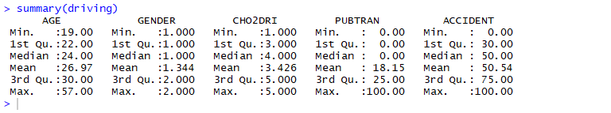
Summary:

Slide 6
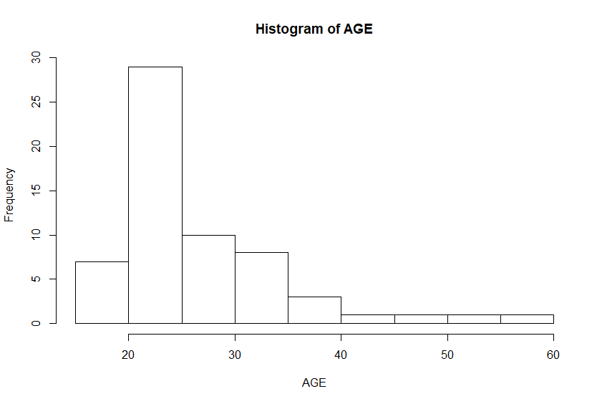
What are the mean and median ages? a histogram of the distribution of the ages:
> mean(AGE)
[1] 26.96721
> median(AGE)
[1] 24
Positive Skewness
Mode<median<mean

Slide 7
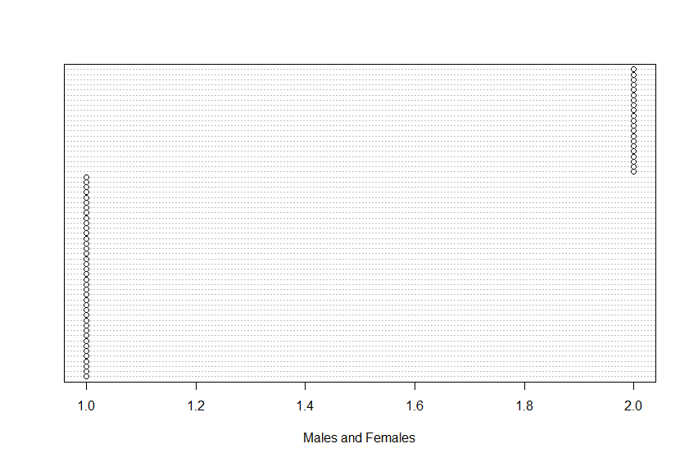
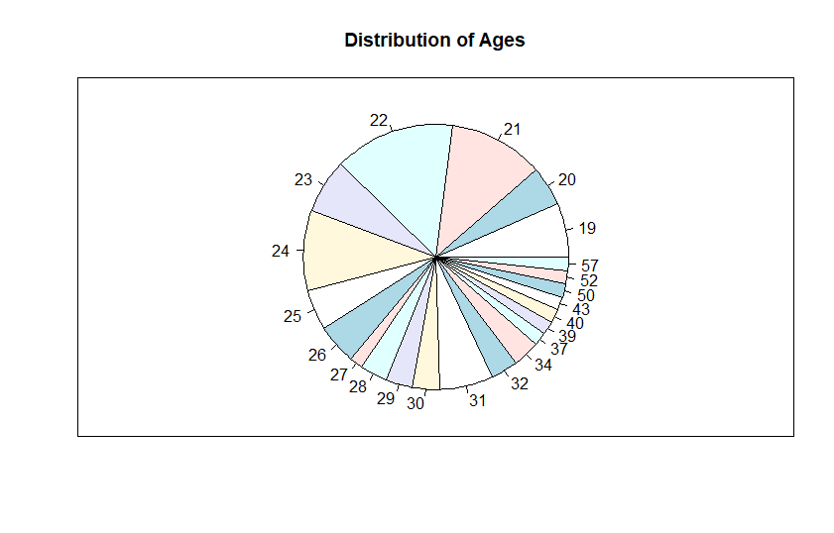
Dot plot FOR GENDER AND PIECHART for AGES

Slide 8
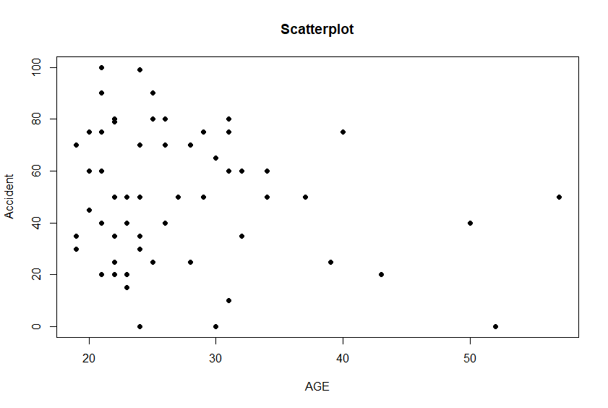
scatterplot (age, accident)
plot(AGE, ACCIDENT, main="Scatterplot", xlab="AGE", ylab="Accident", pch=19)

Slide 9
What is the mean percentage of time that the participants spend in traveling on public transportation during inclement weather? What is the standard deviation of Pubtran?
mean percentage
> mean(PUBTRAN)
[1] 18.14754
> median(PUBTRAN)
[1] 0
> percent2 <- (mean(PUBTRAN)/61)*100
> percent2
[1] 29.75007
sd(PUBTRAN)
[1] 31.32881

Slide 10
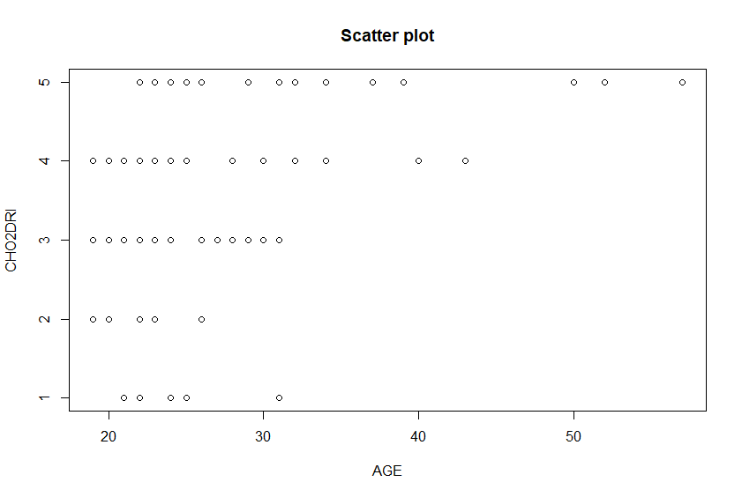
What is the correlation between age and how often the person chooses to drive in inclement weather? a 95% confidence interval on the correlation between age. how often the person chooses to drive in inclement weather ?
> plot(AGE, CHO2DRI, main = "Scatter plot")
> cor(AGE, CHO2DRI)
[1] 0.4394836
TEST
> cor.test(AGE, CHO2DRI)
Pearson's product-moment correlation
data: AGE and CHO2DRI
t = 3.7581, df = 59, p-value = 0.0003947
alternative hypothesis: true correlation is not equal to 0
95 percent confidence interval:
0.2110163 0.6224204
sample estimates:
cor
0.4394836
CONCLUSION: moderate Correlation
Reject H0;

Slide 11
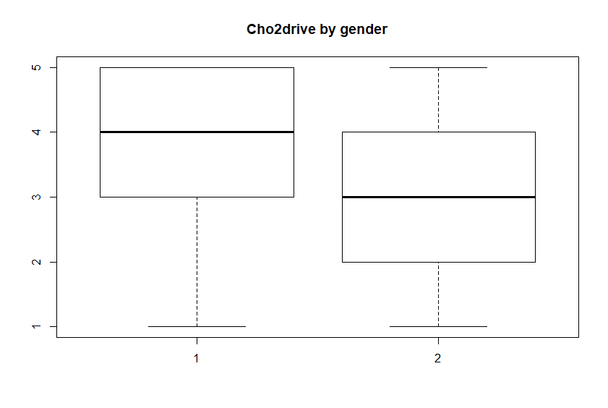
BOXPLOT OF CHO2DRIVE BY GENDER:
>boxplot(CHO2DRI~GENDER, main="Cho2drive by gender", ylim=c(0,5))
> mean(CHO2DRI)
[1] 3.42623
>
> mean(GENDER)
[1] 1.344262

Slide 12
Is there a gender difference in the likelihood to drive in inclement weather? (TWO SAMPLE)
> t.test(CHO2DRI ~ GENDER, mu=0, alt="two.sided", con.level=0.95, var.eq=F, paired=F)
Welch Two Sample t-test
data: CHO2DRI by GENDER
t = 1.1548, df = 38.085, p-value = 0.2554
alternative hypothesis: true difference in means is not equal to 0
95 percent confidence interval:
-0.325380 1.189666
sample estimates:
mean in group 1 mean in group 2
3.575000 3.142857
H0= mu(gender) =mu(choose)
H1=mu(gender) !=mu(choose)
Alpha=0.05
Conc: H0 rejected

Slide 13
(ONE SAMPLE TEST)ON % of accidents thought to occur from driving in inclement weather
> t.test(ACCIDENT, mu=3, con.level=0.95)
One Sample t-test
data: ACCIDENT
t = 14.462, df = 60, p-value < 2.2e-16
alternative hypothesis: true mean is not equal to 3
95 percent confidence interval:
43.96558 57.11639
sample estimates:
mean of x
50.54098
H0= mu=3
H1=mu!=3
Alpha=0.05
Conc: H0 Reject

Slide 14
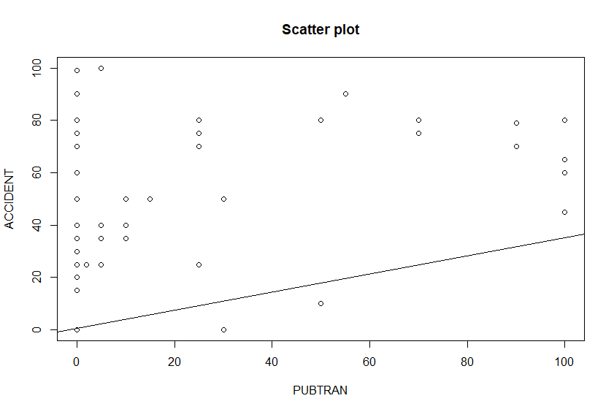
Use linear regression to predict how often someone rides public transportation in inclement weather from what percentage of accidents that person thinks occur in inclement weather. (Pubtran by Accident)
Regression is used to access the level of relationship between two or more variables.
> plot(PUBTRAN, ACCIDENT ,main="Scatter plot")
> cor(PUBTRAN, ACCIDENT)
[1] 0.2846271
>
> mod <- lm(PUBTRAN ~ ACCIDENT)
> summary(mod)
Call:
lm(formula = PUBTRAN ~ ACCIDENT)
Residuals:
Min 1Q Median 3Q Max
-34.978 -17.960 -7.750 -0.594 83.777
Coefficients:
Estimate Std. Error t value Pr(>|t|)
(Intercept) 0.5937 8.6187 0.069 0.9453
ACCIDENT 0.3473 0.1523 2.281 0.0262 *
---
Signif. codes: 0 ‘***’ 0.001 ‘**’ 0.01 ‘*’ 0.05 ‘.’ 0.1 ‘ ’ 1
Residual standard error: 30.29 on 59 degrees of freedom
Multiple R-squared: 0.08101, Adjusted R-squared: 0.06544
F-statistic: 5.201 on 1 and 59 DF, p-value: 0.0262
> abline(mod)

Slide 15
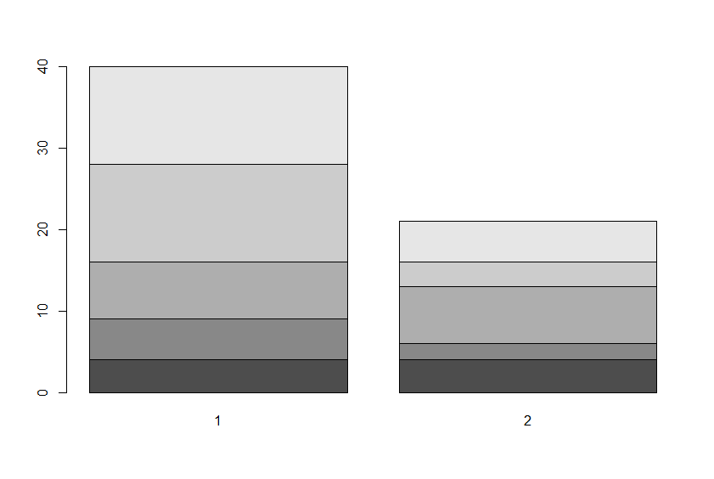
Chi-square on How often he or she chooses to drive in inclement weather
This test is used to derive the statistical significance of relationship between the variables. Also, it tests whether the evidence in the sample is strong enough to generalize that the relationship for a larger population as well.
> tab= table(CHO2DRI, GENDER)
> tab
GENDER
CHO2DRI 1 2
1 4 4
2 5 2
3 7 7
4 12 3
5 12 5
> barplot(tab)
> chisq.test(tab, correct=T)
Pearson's Chi-squared test
data: tab
X-squared = 4.0422, df = 4, p-value = 0.4003
> CHI$expected
GENDER
CHO2DRI 1 2
1 5.245902 2.754098
2 4.590164 2.409836
3 9.180328 4.819672
4 9.836066 5.163934
5 11.147541 5.852459
Don’t reject H0, bec pvalue smaller than 0.05

Slide 16
THANK YOU

